Slide 1


Calculus and applications
MTH10012
Week 10

Slide 2
Introduction
Week 9
TEST 2
Definite integration; areas between two curves and arc lengths
Differential equations: definition, classification, solutions
Elementary and separable first order ODEs and initial value problems
MODULE 6
Week 10
First order linear DE: integrating factors
Application of first order ODEs: population models and R-L series circuit
Second order ODEs with constant coefficients
General solution for the homogeneous and inhomogeneous cases

Slide 3
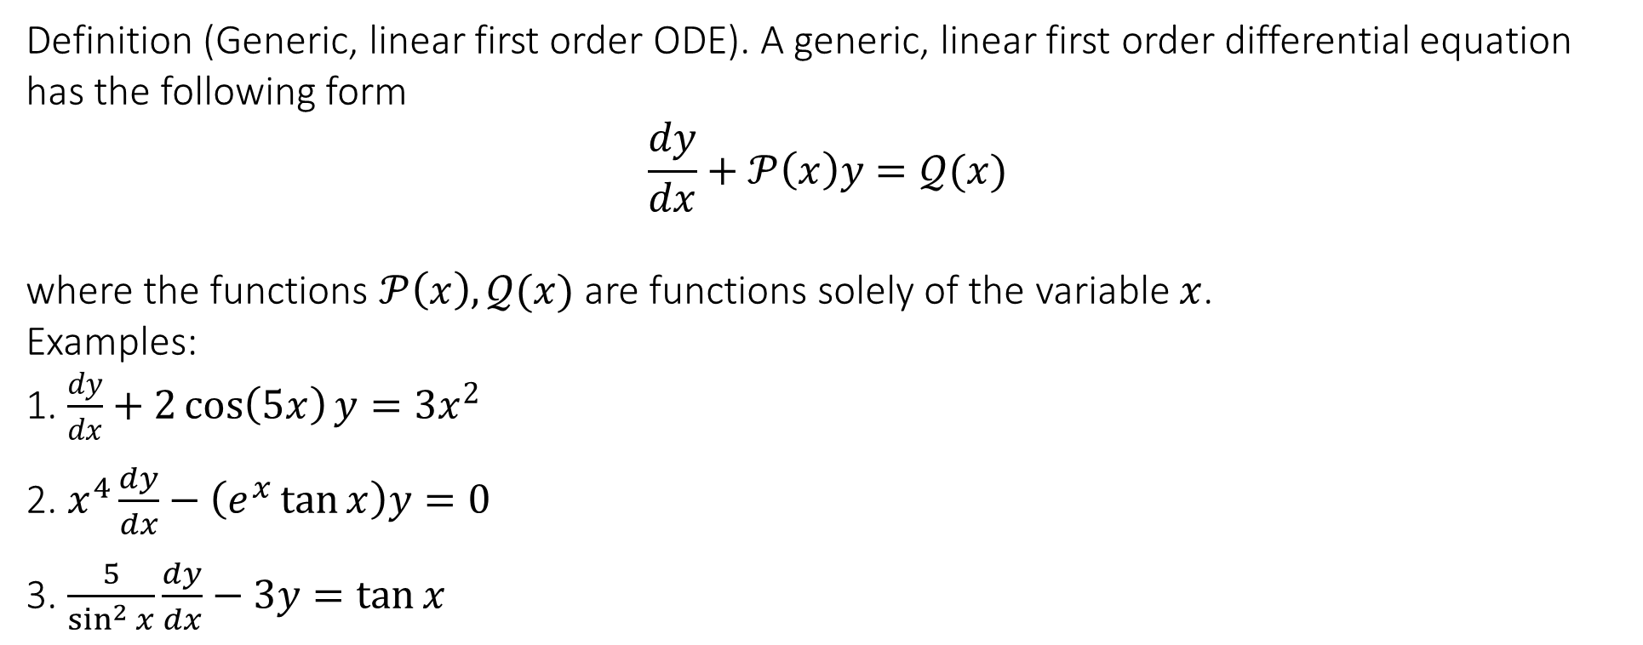
6.3 First order linear DE: integrating factors
Definition (Generic, linear first order ODE). A generic, linear first order differential equation has the following form
$$\frac{dy}{dx}+𝒫\left(x\right)y=𝒬(x)$$
where the functions $𝒫\left(x\right),𝒬(x)$ are functions solely of the variable $x$.
Examples:
1. $\frac{dy}{dx}+2\cos\left(5x\right)y=3x^{2}$
2. $x^{4}\frac{dy}{dx}−\left(e^{x}\tan{x}\right)y=0$
3. $\frac{5}{\sin^{2}{x}}\frac{dy}{dx}−3y=\tan{x}$

Slide 4

6.3 First order linear DE: integrating factors
Theorem (Integrating factor method). Given a generic, linear first order ODE
$$\frac{dy}{dx}+𝒫\left(x\right)y=𝒬(x)$$
a solution $y(x)$ is given by
$$y\left(x\right)=\frac{1}{ℐ\left(x\right)}\int{𝒬\left(x\right)ℐ\left(x\right)dx}$$
where $ℐ(x)$ is called the integrating factor. This factor is given by
$$ℐ\left(x\right)=e^{\int{𝒫\left(x\right)dx}}$$

Slide 5
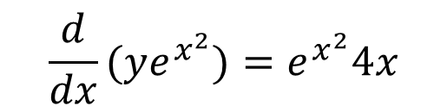
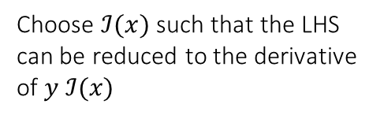
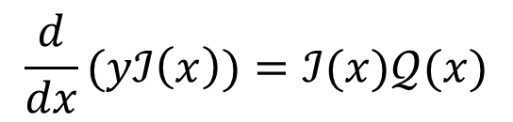
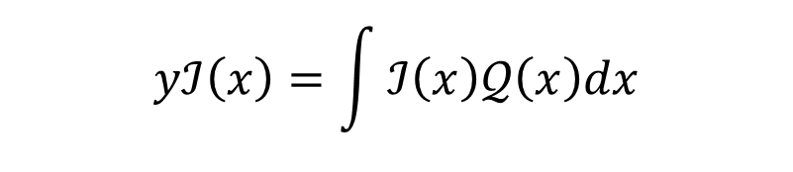
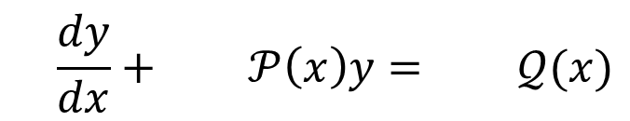
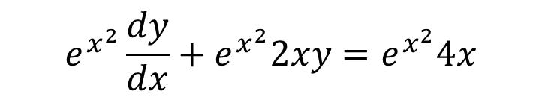
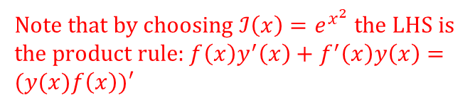
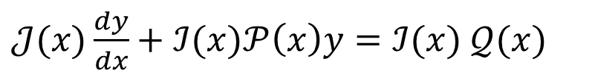
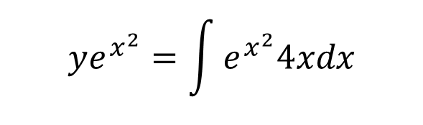
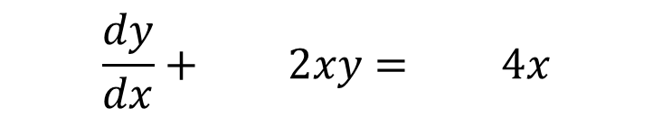
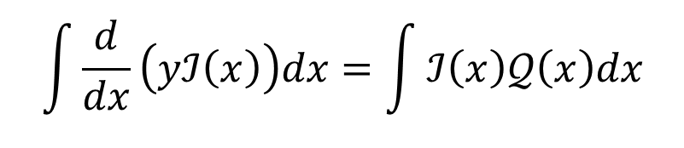
6.3 First order linear DE: integrating factors
$$\frac{dy}{dx}+ 𝒫\left(x\right)y= 𝒬(x)$$
$$\frac{dy}{dx}+ 2xy= 4x$$
Multiply by the integrating factor
Choose $ℐ(x)$ such that the LHS can be reduced to the derivative of $y ℐ(x)$
$$e^{x^{2}}\frac{dy}{dx}+e^{x^{2}}2xy=e^{x^{2}}4x$$
$𝒥(x)\frac{dy}{dx}+ℐ(x)𝒫\left(x\right)y=ℐ(x)$ $𝒬(x)$
Note that by choosing $ℐ\left(x\right)=e^{x^{2}}$ the LHS is the product rule:$f\left(x\right)y^{′}\left(x\right)+f^{′}\left(x\right)y\left(x\right)=(y(x)f\left(x\right))′$
$$\frac{d}{dx}(yℐ\left(x\right))=ℐ(x)𝒬(x)$$
$$\frac{d}{dx}(ye^{x^{2}})=e^{x^{2}}4x$$
$$\int{\frac{d}{dx}\left(yℐ\left(x\right)\right)dx}=\int{ℐ\left(x\right)𝒬\left(x\right)dx}$$
$$ye^{x^{2}}=\int{e^{x^{2}}4xdx}$$
Integrate both sides
$$yℐ\left(x\right)=\int{ℐ\left(x\right)𝒬\left(x\right)dx}$$

Slide 6
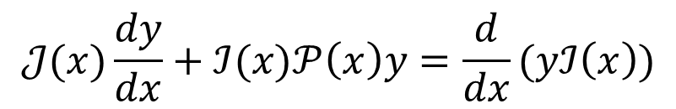
6.3 First order linear DE: integrating factors
To find the integrating factor:
$$𝒥(x)\frac{dy}{dx}+ℐ(x)𝒫\left(x\right)y=\frac{d}{dx}(yℐ\left(x\right))$$

Slide 7
6.3 First order linear DE: integrating factors
Solve the equation: $\frac{dy}{dx}+\frac{y}{x}=\cosh{x}$, assumed that $x≠0$

Slide 8

6.3 First order linear DE: integrating factors
Find the solution to the following IVP:$\left\{\begin{matrix}\frac{dy}{dx}+y\tan{x}=\cos^{3}{x} \\ y\left(0\right)=1\end{matrix}\right.$

Slide 9
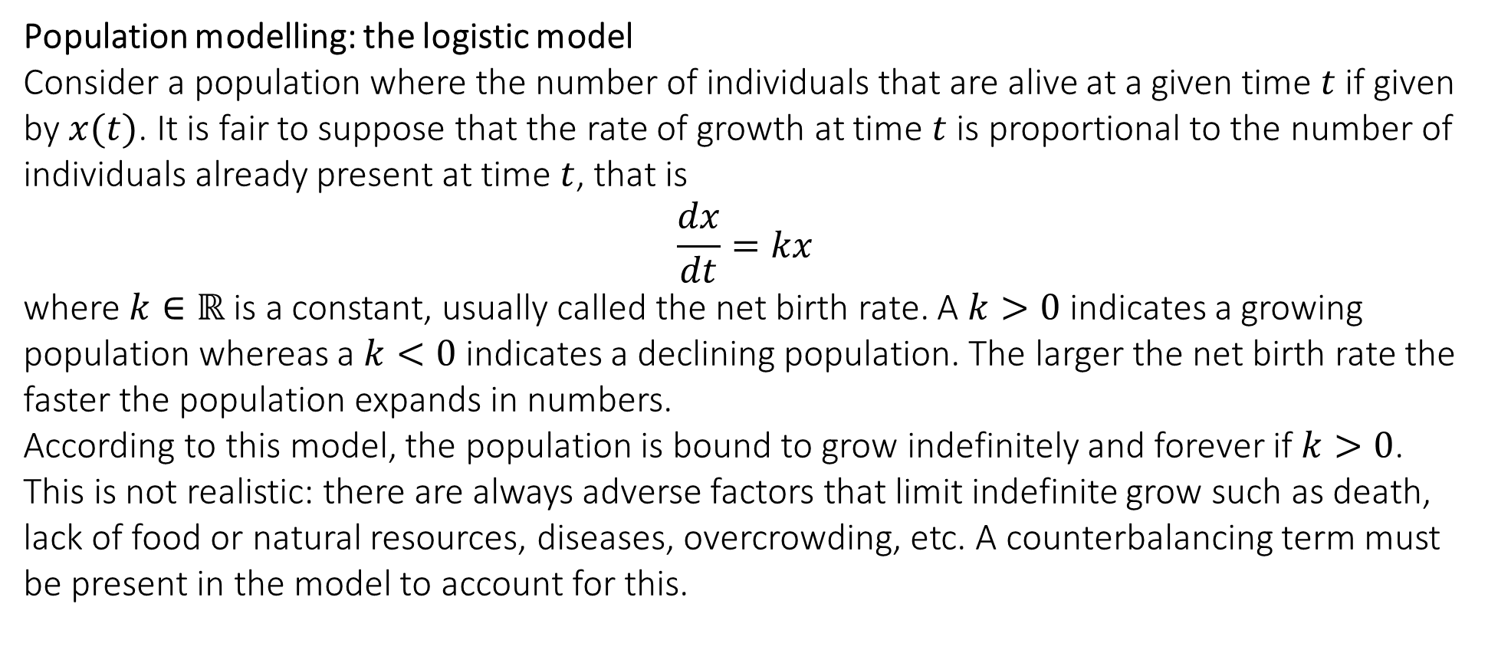
6.4 Applications of first order ODEs
Population modelling: the logistic model
Consider a population where the number of individuals that are alive at a given time $t$ if given by $x(t)$. It is fair to suppose that the rate of growth at time $t$ is proportional to the number of individuals already present at time $t$, that is
$$\frac{dx}{dt}=kx$$
where $k∈ℝ$ is a constant, usually called the net birth rate. A $k>0$ indicates a growing population whereas a $k<0$ indicates a declining population. The larger the net birth rate the faster the population expands in numbers.
According to this model, the population is bound to grow indefinitely and forever if $k>0$. This is not realistic: there are always adverse factors that limit indefinite grow such as death, lack of food or natural resources, diseases, overcrowding, etc. A counterbalancing term must be present in the model to account for this.

Slide 10
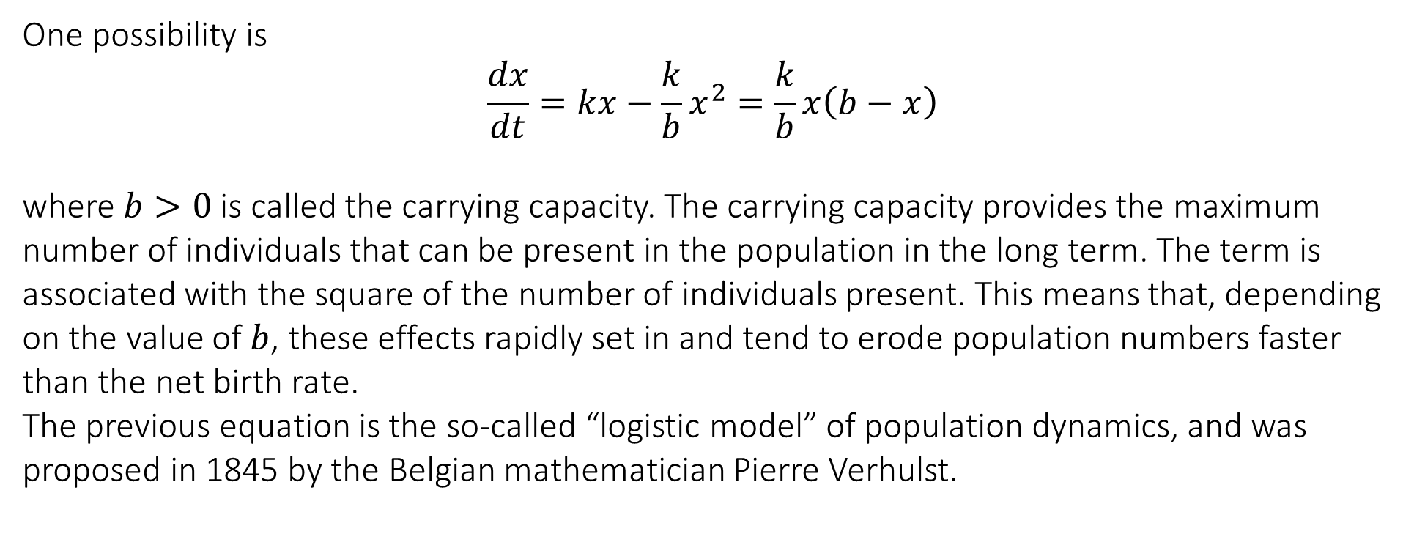
6.4 Applications of first order ODEs
One possibility is
$$\frac{dx}{dt}=kx−\frac{k}{b}x^{2}=\frac{k}{b}x\left(b−x\right)$$
where $b>0$ is called the carrying capacity. The carrying capacity provides the maximum number of individuals that can be present in the population in the long term. The term is associated with the square of the number of individuals present. This means that, depending on the value of $b$, these effects rapidly set in and tend to erode population numbers faster than the net birth rate.
The previous equation is the so-called “logistic model” of population dynamics, and was proposed in 1845 by the Belgian mathematician Pierre Verhulst.

Slide 11

6.4 Applications of first order ODEs
To solve the equation we use separation of variables:
$$\frac{dx}{dt}=\frac{k}{b}x\left(b−x\right)$$

Slide 12
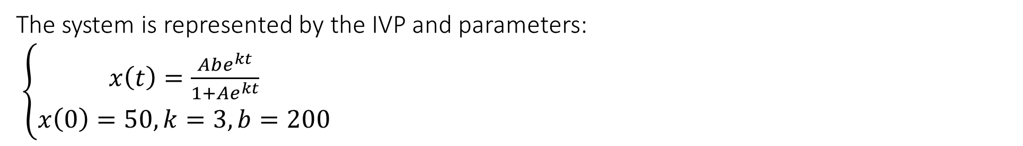
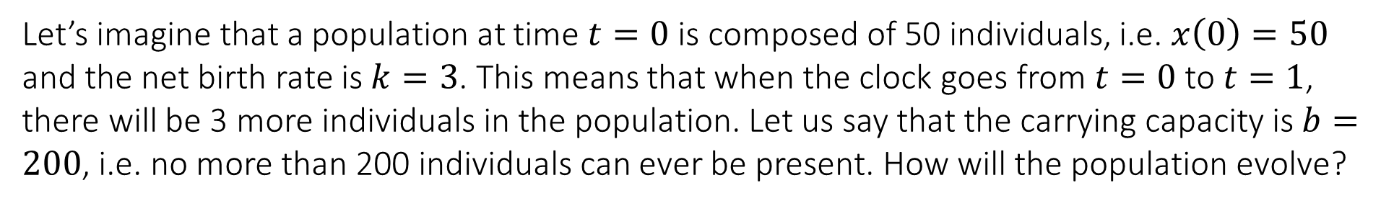
6.4 Applications of first order ODEs
Let’s imagine that a population at time $t=0$ is composed of 50 individuals, i.e. $x\left(0\right)=50$ and the net birth rate is $k=3$. This means that when the clock goes from $t=0$ to $t=1$, there will be 3 more individuals in the population. Let us say that the carrying capacity is $b=200$, i.e. no more than 200 individuals can ever be present. How will the population evolve?
The system is represented by the IVP and parameters:
$\left\{\begin{matrix}x\left(t\right)=\frac{Abe^{kt}}{1+Ae^{kt}} \\ x\left(0\right)=50, k=3,b=200\end{matrix}\right.$

Slide 13
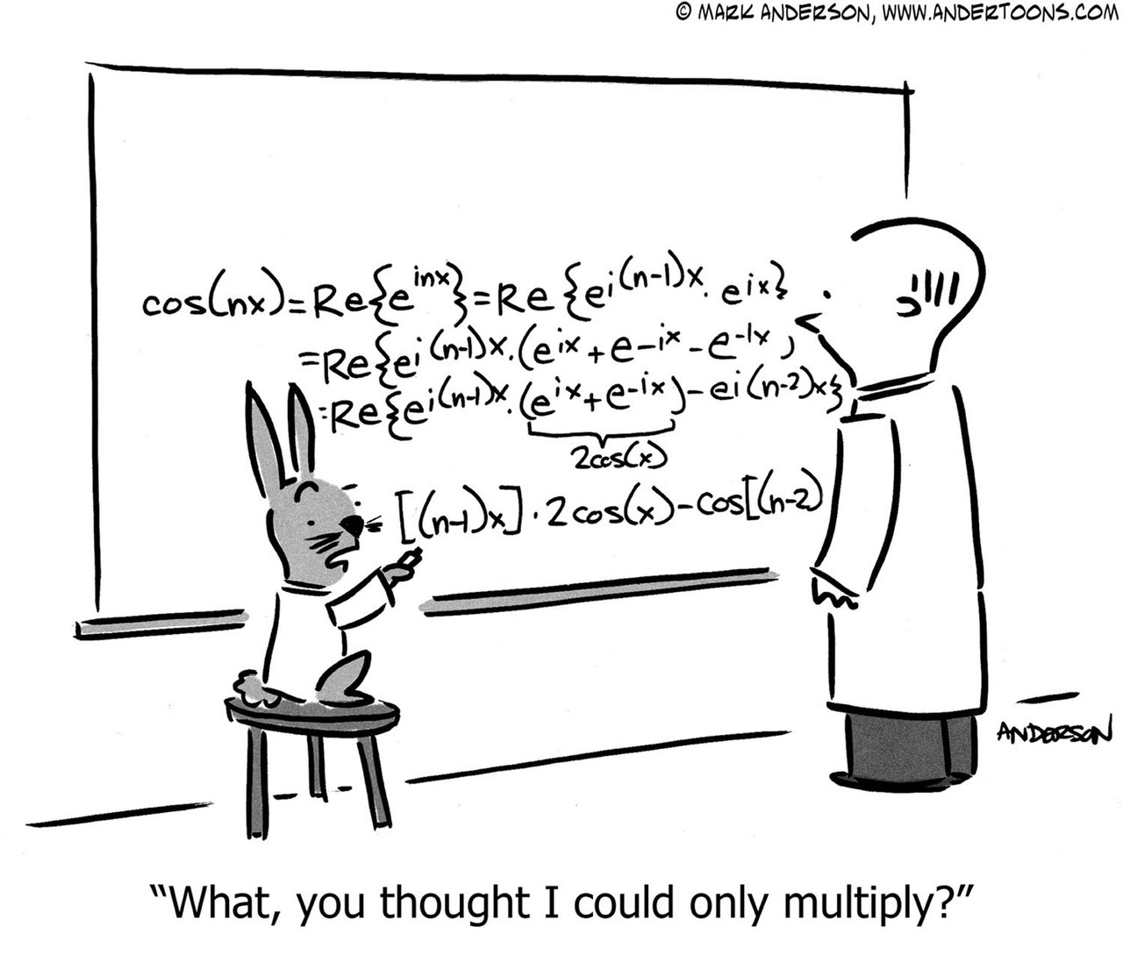
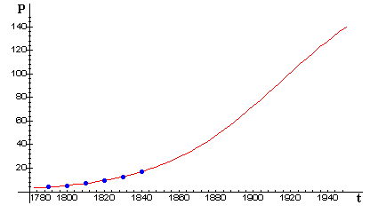
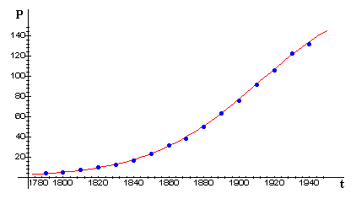
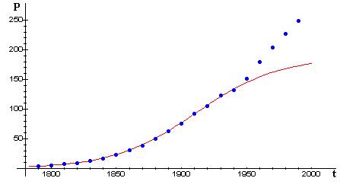
6.4 Applications of first order ODEs
Population modelling: the logistic model
Verhulst used his model to predict the US population in 1940.

Slide 14
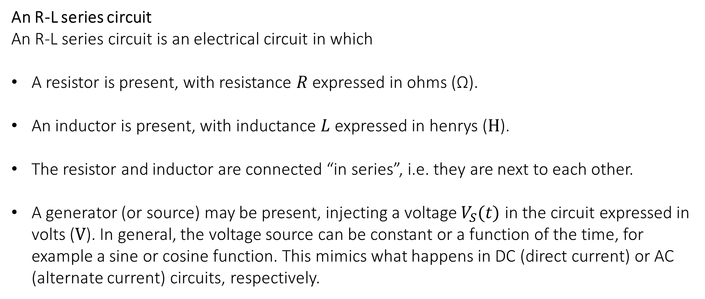
6.4 Applications of first order ODEs
An R-L series circuit
An R-L series circuit is an electrical circuit in which
A resistor is present, with resistance $R$ expressed in ohms (Ω).
An inductor is present, with inductance $L$ expressed in henrys ($H$).
The resistor and inductor are connected “in series”, i.e. they are next to each other.
A generator (or source) may be present, injecting a voltage $V_{S}(t)$ in the circuit expressed in volts ($V$). In general, the voltage source can be constant or a function of the time, for example a sine or cosine function. This mimics what happens in DC (direct current) or AC (alternate current) circuits, respectively.

Slide 15
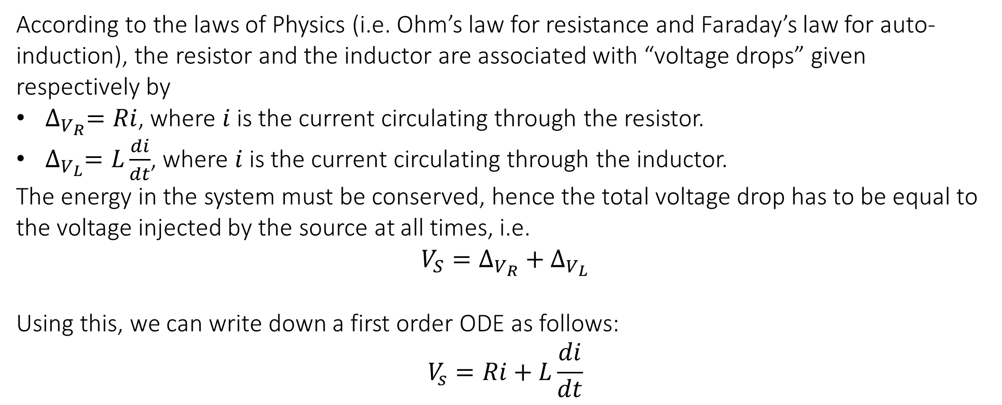
6.4 Applications of first order ODEs
According to the laws of Physics (i.e. Ohm’s law for resistance and Faraday’s law for auto-induction), the resistor and the inductor are associated with “voltage drops” given respectively by
$∆_{V_{R}}=Ri$, where $i$ is the current circulating through the resistor.
$∆_{V_{L}}=L\frac{di}{dt}$, where $i$ is the current circulating through the inductor.
The energy in the system must be conserved, hence the total voltage drop has to be equal to the voltage injected by the source at all times, i.e.
$$V_{S}=∆_{V_{R}}+∆_{V_{L}}$$
Using this, we can write down a first order ODE as follows:
$$V_{s}=Ri+L\frac{di}{dt}$$

Slide 16
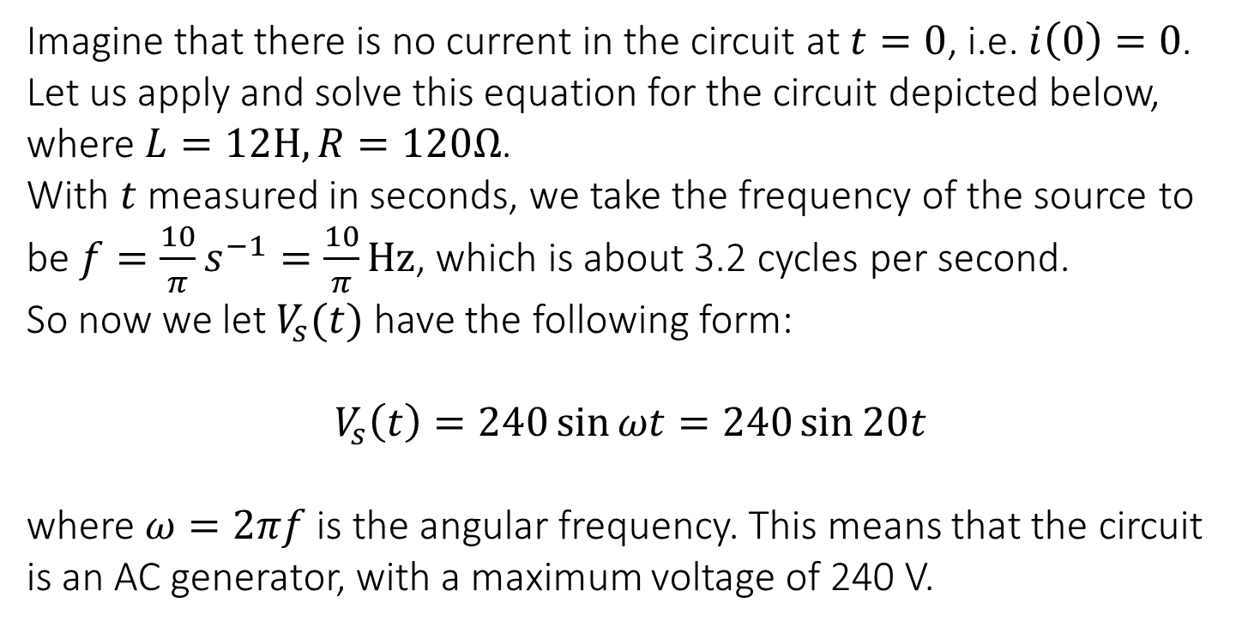
6.4 Applications of first order ODEs
Imagine that there is no current in the circuit at $t=0$, i.e. $i\left(0\right)=0$. Let us apply and solve this equation for the circuit depicted below, where $L=12H, R=120Ω$.
Imagine that there is no current in the circuit at $t=0$, i.e. $i\left(0\right)=0$. Let us apply and solve this equation for the circuit depicted below, where $L=12H, R=120Ω$.
With $t$ measured in seconds, we take the frequency of the source to be $f=\frac{10}{π}s^{−1}=\frac{10}{π}Hz$, which is about 3.2 cycles per second.
So now we let $V_{s}(t)$ have the following form:
$$V_{s}\left(t\right)=240\sin{ωt}=240\sin{20t}$$
where $ω=2πf$ is the angular frequency. This means that the circuit is an AC generator, with a maximum voltage of 240 V.

Slide 17

6.4 Applications of first order ODEs
This is, mathematically, an IVP for a linear ODE:$\left\{\begin{matrix}12\frac{di}{dt}+120i=240\sin{20t} \\ i\left(0\right)=0\end{matrix}\right.$

Slide 18
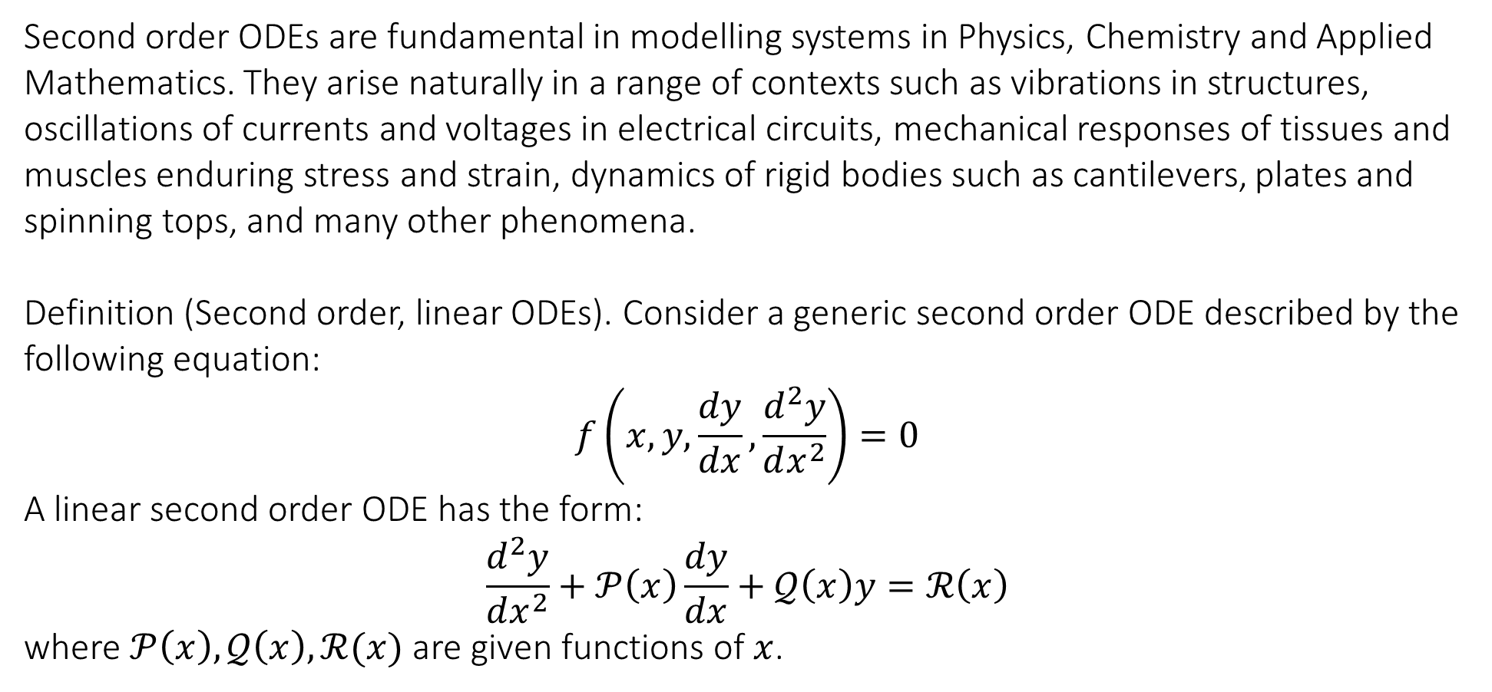
6.5 Second order linear ODEs with constant coefficients
Second order ODEs are fundamental in modelling systems in Physics, Chemistry and Applied Mathematics. They arise naturally in a range of contexts such as vibrations in structures, oscillations of currents and voltages in electrical circuits, mechanical responses of tissues and muscles enduring stress and strain, dynamics of rigid bodies such as cantilevers, plates and spinning tops, and many other phenomena.
Definition (Second order, linear ODEs). Consider a generic second order ODE described by the following equation:
$$f\left(x,y,\frac{dy}{dx},\frac{d^{2}y}{dx^{2}}\right)=0$$
A linear second order ODE has the form:
$$\frac{d^{2}y}{dx^{2}}+𝒫\left(x\right)\frac{dy}{dx}+𝒬\left(x\right)y=ℛ\left(x\right)$$
where $𝒫\left(x\right),𝒬\left(x\right),ℛ(x)$ are given functions of $x$.

Slide 19
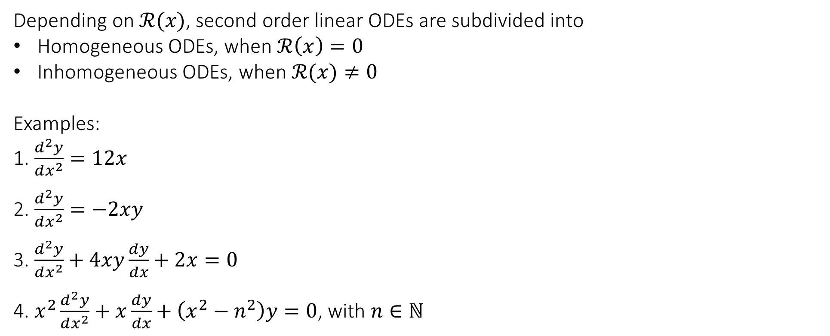
6.5 Second order linear ODEs with constant coefficients
Depending on $ℛ(x)$, second order linear ODEs are subdivided into
Homogeneous ODEs, when $ℛ\left(x\right)=0$
Inhomogeneous ODEs, when $ℛ(x)≠0$
Examples:
1. $\frac{d^{2}y}{dx^{2}}=12x$
2. $\frac{d^{2}y}{dx^{2}}=−2xy$
3. $\frac{d^{2}y}{dx^{2}}+4xy\frac{dy}{dx}+2x=0$
4. $x^{2}\frac{d^{2}y}{dx^{2}}+x\frac{dy}{dx}+\left(x^{2}−n^{2}\right)y=0$, with $n∈ℕ$

Slide 20
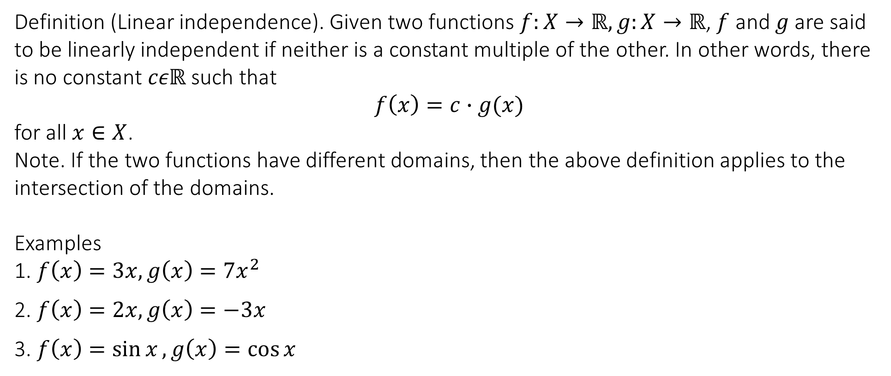
6.5 Second order linear ODEs with constant coefficients
Definition (Linear independence). Given two functions $f:X→ℝ, g:X→ℝ$, $f$ and $g$ are said to be linearly independent if neither is a constant multiple of the other. In other words, there is no constant $cεℝ$ such that
$$f\left(x\right)=c∙g(x)$$
for all $x∈X$.
Note. If the two functions have different domains, then the above definition applies to the intersection of the domains.
Examples
1. $f\left(x\right)=3x, g\left(x\right)=7x^{2}$
2. $f\left(x\right)=2x, g\left(x\right)=−3x$
3. $f\left(x\right)=\sin{x}, g\left(x\right)=\cos{x}$

Slide 21
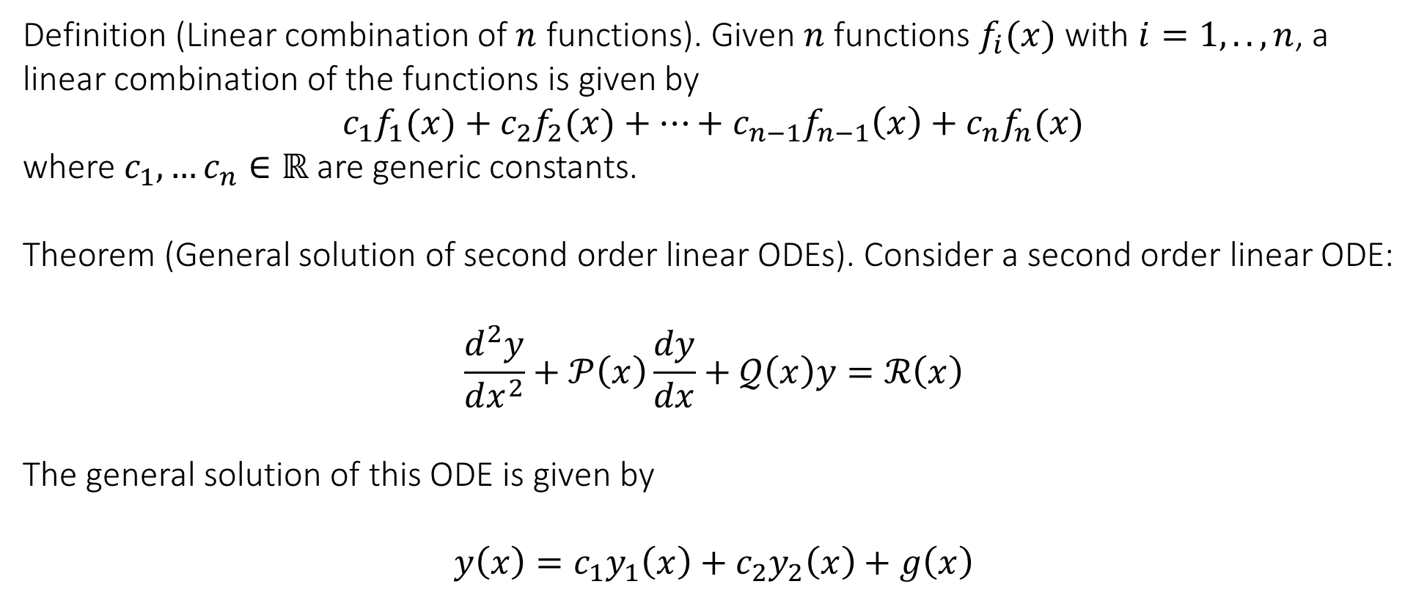
6.5 Second order linear ODEs with constant coefficients
Definition (Linear combination of $n$ functions). Given $n$ functions $f_{i}(x)$ with $i=1,..,n$, a linear combination of the functions is given by
$$c_{1}f_{1}(x)+c_{2}f_{2}(x)+…+c_{n−1}f_{n−1}\left(x\right)+c_{n}f_{n}(x)$$
where $c_{1},…c_{n}∈ℝ$ are generic constants.
Theorem (General solution of second order linear ODEs). Consider a second order linear ODE:
$$\frac{d^{2}y}{dx^{2}}+𝒫\left(x\right)\frac{dy}{dx}+𝒬\left(x\right)y=ℛ\left(x\right)$$
The general solution of this ODE is given by
$$y\left(x\right)=c_{1}y_{1}\left(x\right)+c_{2}y_{2}\left(x\right)+g\left(x\right)$$

Slide 22
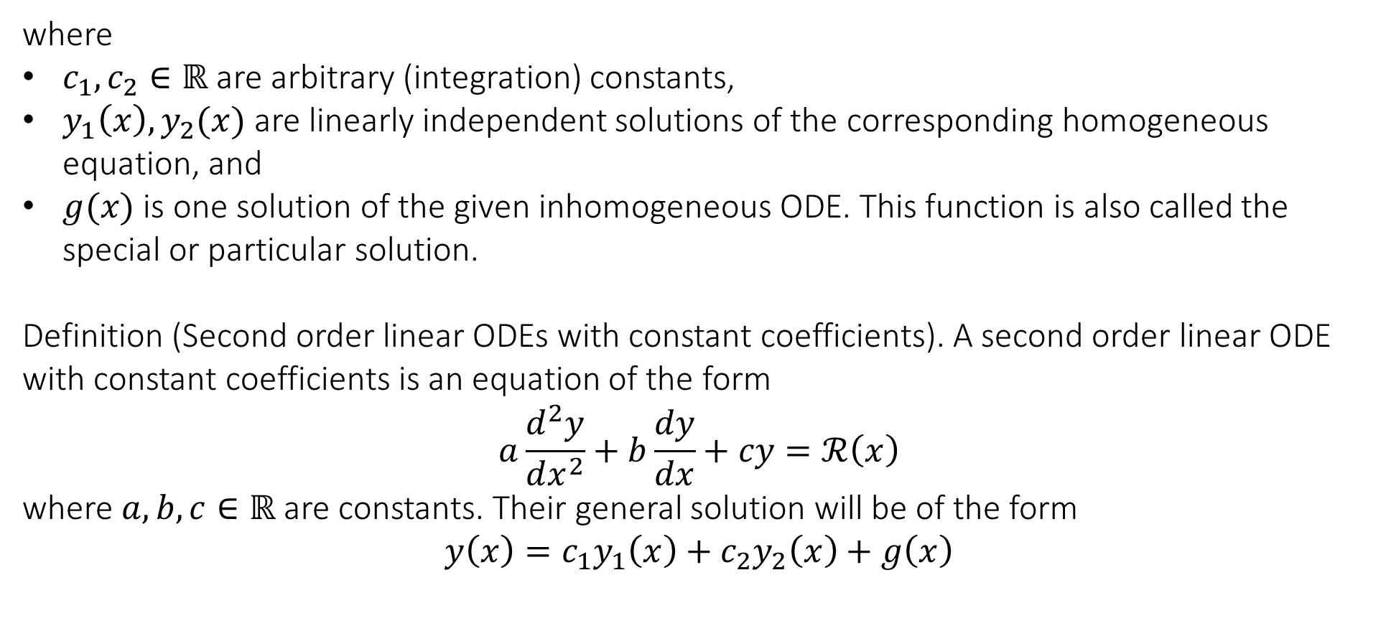
6.5 Second order linear ODEs with constant coefficients
where
$c_{1},c_{2}∈ℝ$ are arbitrary (integration) constants,
$y_{1}\left(x\right), y_{2}(x)$ are linearly independent solutions of the corresponding homogeneous equation, and
$g(x)$ is one solution of the given inhomogeneous ODE. This function is also called the special or particular solution.
Definition (Second order linear ODEs with constant coefficients). A second order linear ODE with constant coefficients is an equation of the form
$$a\frac{d^{2}y}{dx^{2}}+b\frac{dy}{dx}+cy=ℛ\left(x\right)$$
where $a,b,c∈ℝ$ are constants. Their general solution will be of the form
$$y\left(x\right)=c_{1}y_{1}\left(x\right)+c_{2}y_{2}\left(x\right)+g\left(x\right)$$

Slide 23
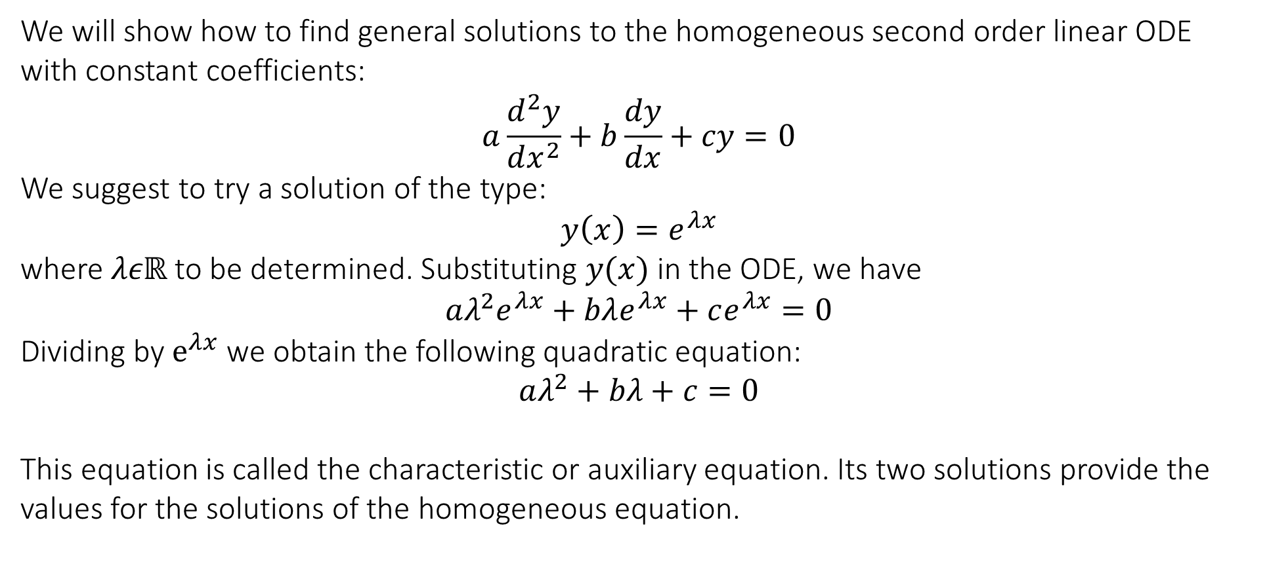
6.6 General solution for the homogeneous case
We will show how to find general solutions to the homogeneous second order linear ODE with constant coefficients:
$$a\frac{d^{2}y}{dx^{2}}+b\frac{dy}{dx}+cy=0$$
We suggest to try a solution of the type:
$$y\left(x\right)=e^{λx}$$
where $λεℝ$ to be determined. Substituting $y(x)$ in the ODE, we have
$$aλ^{2}e^{λx}+bλe^{λx}+ce^{λx}=0$$
Dividing by $e^{λx}$ we obtain the following quadratic equation:
$$aλ^{2}+bλ+c=0$$
This equation is called the characteristic or auxiliary equation. Its two solutions provide the values for the solutions of the homogeneous equation.

Slide 24
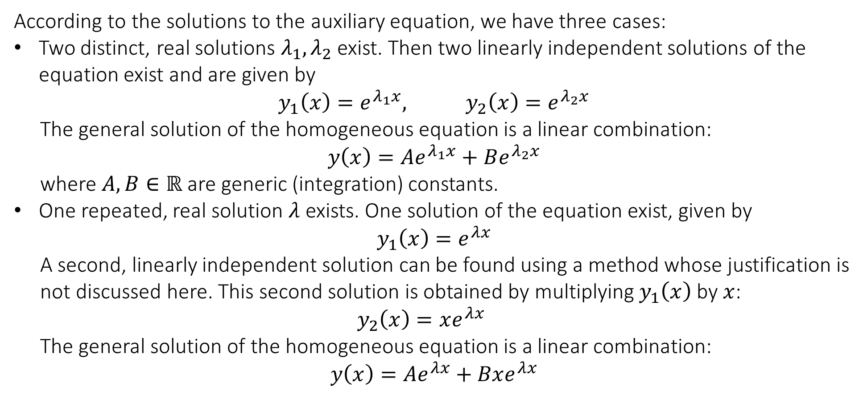
6.6 General solution for the homogeneous case
According to the solutions to the auxiliary equation, we have three cases:
Two distinct, real solutions $λ_{1},λ_{2}$ exist. Then two linearly independent solutions of the equation exist and are given by
$$y_{1}\left(x\right)=e^{λ_{1}x}, y_{2}\left(x\right)=e^{λ_{2}x}$$
The general solution of the homogeneous equation is a linear combination:
$$y\left(x\right)=Ae^{λ_{1}x}+Be^{λ_{2}x}$$
where $A,B∈ℝ$ are generic (integration) constants.
One repeated, real solution $λ$ exists. One solution of the equation exist, given by
$$y_{1}\left(x\right)=e^{λx}$$
A second, linearly independent solution can be found using a method whose justification is not discussed here. This second solution is obtained by multiplying $y_{1}\left(x\right)$ by $x$:
$$y_{2}\left(x\right)=xe^{λx}$$
The general solution of the homogeneous equation is a linear combination:
$$y\left(x\right)=Ae^{λx}+Bxe^{λx}$$

Slide 25
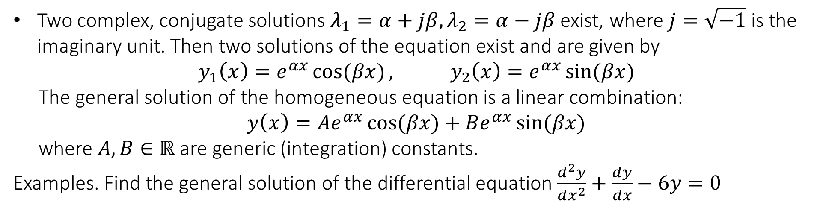
6.6 General solution for the homogeneous case
Two complex, conjugate solutions $λ_{1}=α+jβ,λ_{2}=α−jβ$ exist, where $j=\sqrt{−1}$ is the imaginary unit. Then two solutions of the equation exist and are given by
$$y_{1}\left(x\right)=e^{αx}\cos{(βx)}, y_{2}\left(x\right)=e^{αx}\sin{(βx)}$$
The general solution of the homogeneous equation is a linear combination:
$$y\left(x\right)=Ae^{αx}\cos{(βx)}+Be^{αx}\sin{(βx)}$$
where $A,B∈ℝ$ are generic (integration) constants.
Examples. Find the general solution of the differential equation$\frac{d^{2}y}{dx^{2}}+\frac{dy}{dx}−6y=0$

Slide 26
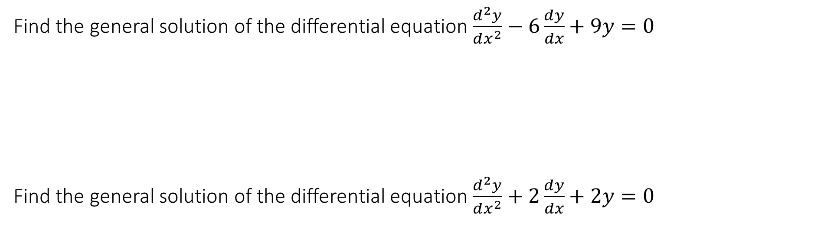
6.6 General solution for the homogeneous case
Find the general solution of the differential equation$\frac{d^{2}y}{dx^{2}}−6\frac{dy}{dx}+9y=0$
Find the general solution of the differential equation$\frac{d^{2}y}{dx^{2}}+2\frac{dy}{dx}+2y=0$

Slide 27
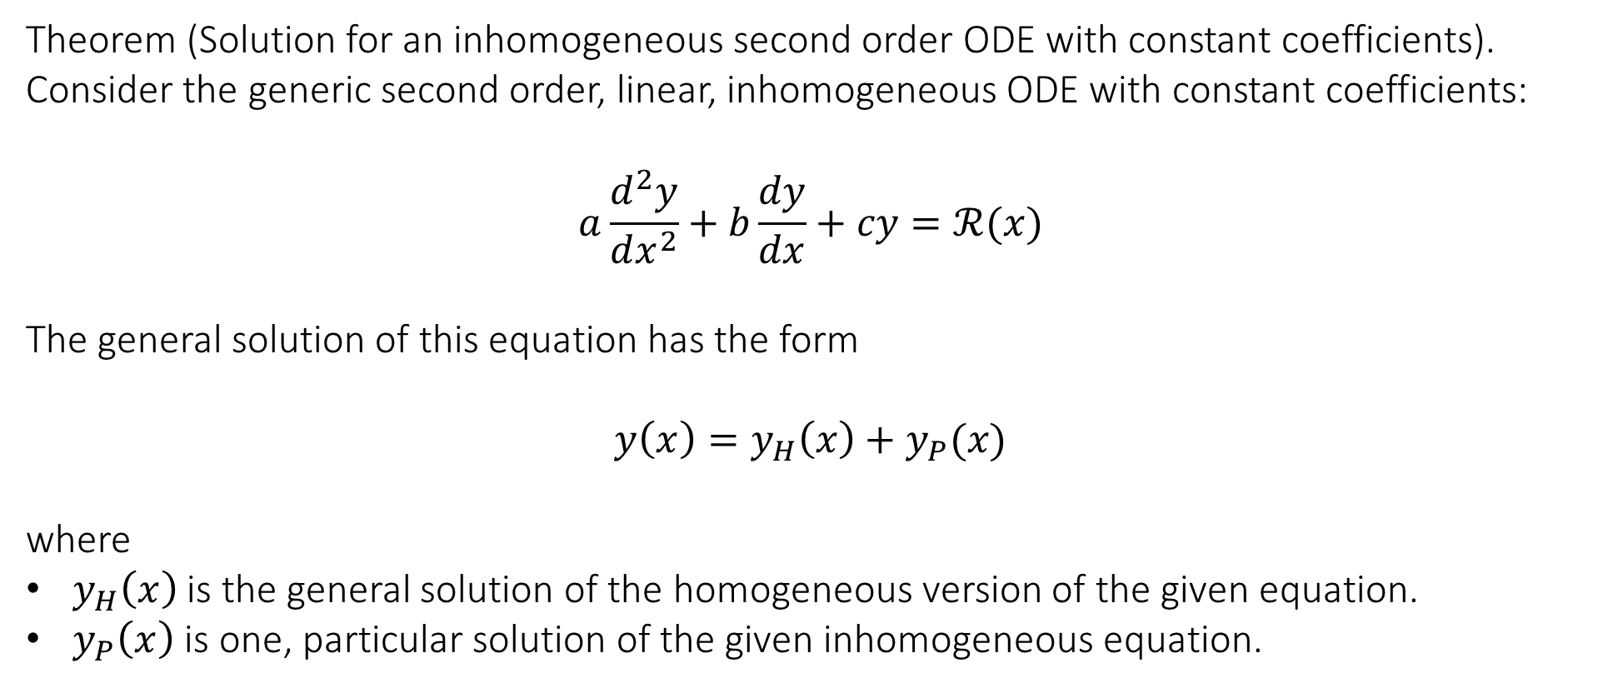
6.7 General solution for the inhomogeneous case
Theorem (Solution for an inhomogeneous second order ODE with constant coefficients). Consider the generic second order, linear, inhomogeneous ODE with constant coefficients:
$$a\frac{d^{2}y}{dx^{2}}+b\frac{dy}{dx}+cy=ℛ(x)$$
The general solution of this equation has the form
$$y\left(x\right)=y_{H}\left(x\right)+y_{P}(x)$$
where
$y_{H}\left(x\right)$ is the general solution of the homogeneous version of the given equation.
$y_{P}\left(x\right)$ is one, particular solution of the given inhomogeneous equation.

Slide 28
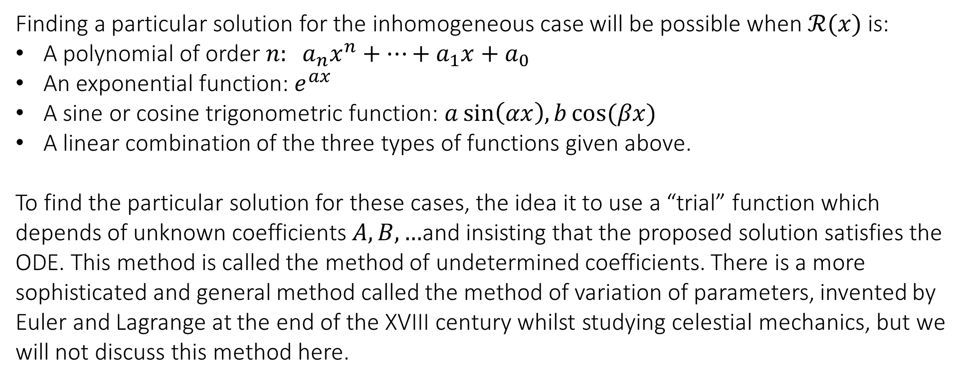
6.7 General solution for the inhomogeneous case
Finding a particular solution for the inhomogeneous case will be possible when $ℛ(x)$ is:
A polynomial of order $n: a_{n}x^{n}+…+a_{1}x+a_{0}$
An exponential function: $e^{ax}$
A sine or cosine trigonometric function: $a\sin\left(αx\right),b\cos{(βx)}$
A linear combination of the three types of functions given above.
To find the particular solution for these cases, the idea it to use a “trial” function which depends of unknown coefficients $A,B,…$and insisting that the proposed solution satisfies the ODE. This method is called the method of undetermined coefficients. There is a more sophisticated and general method called the method of variation of parameters, invented by Euler and Lagrange at the end of the XVIII century whilst studying celestial mechanics, but we will not discuss this method here.

Slide 29
6.7 General solution for the inhomogeneous case
Example. Find the general solution to the DE: $\frac{d^{2}y}{dx^{2}}−\frac{dy}{dx}−2y=2x$

Slide 30
End of Lecture

